Slide 1
Process Creation Part 2
Aliza Saeed
aliza.saeed@nu.edu.pk

Slide 2
System Calls
fork()
exec()
wait()
exit()
getpid(), getppid()
getpgrp()

Slide 3
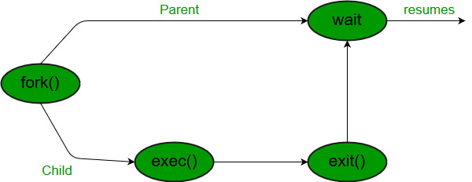

Slide 4

The “fork()” system call - PID
pid<0: the creation of a child process was unsuccessful.
pid==0: the newly created child.
pid>0: the process ID of the child process passes to
the parent.
Consider a piece of program
P1 PID:28
...
pid_t pid = fork(); printf(“PID: %d\n”, pid);
...
P1 PID:28
Fork()
C1 PID:34
The parent will print:
PID: 34
And the child will always print:
PID: 0

Slide 5
The “exec()” System Call
The exec()call replaces a current process’ image with a new one (i.e. loads a new program within current process).
The new image is either regular executable binary file or a
shell script.
There’s not a syscall under the name exec(). By
exec()we usually refer to a family of calls:
int execl(char *path, char *arg, ...);
int execv(char *path, char *argv[]);
int execle(char *path, char *arg, ..., char *envp[]);
int execve(char *path, char *argv[], char *envp[]);
int execlp(char *file, char *arg, ...);
int execvp(char *file, char *argv[]);
Where l=argument list, v=argument vector, e=environmental vector, and p=search path.

Slide 6

The “exec()” System Call
Upon success, exec()never returns to the caller. It replaces the current process image, so it cannot return anything to the program that made the call. If it does return, it means the call failed. Typical reasons are: non- existent file (bad path) or bad permissions.
As a new process is not created, the process identifier (PID) does not change, but the machine code, data, heap, and stack of the process are replaced by those of the new program.
For more info: man 3 exec;
P1 PID:28
Exec()
P1 PID:28
Old Program
New Program

Slide 7
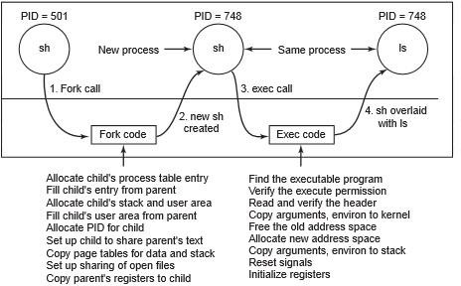


“fork()” and “exec()” combined
Often after doing fork() we want to load a new program into the child. E.g.: a shell
P1 PID:28
fork()
C1 PID:34
C1 PID:34
exec(ls)
C1 PID:34
Old Program
New Program

Slide 8
int execl(const char *path, const char *arg, …, NULL);
execl(“./lab7",“./lab7",NULL);
int execlp(const char *file, const char *arg, …, NULL );
execlp("echo","Hello World!",NULL);
int execv(const char *path, char *const argv[]);
execv(path, (char**)arg);
int execvp(const char *file, char *const argv[]);
execvp("echo", (char**)arg);
int execle(const char *path, const char *arg, …, NULL, char * const envp[] );
execle(path, path, arg1, NULL, (char**)arg);
int execve(const char *file, char *const argv[], char *const envp[]);
execve(path, (char**)arg, (char**)arg1);

Slide 9
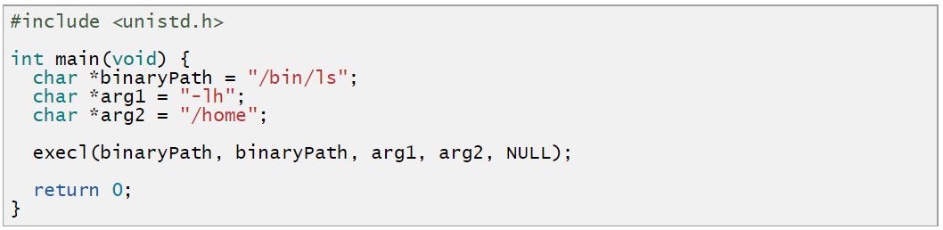
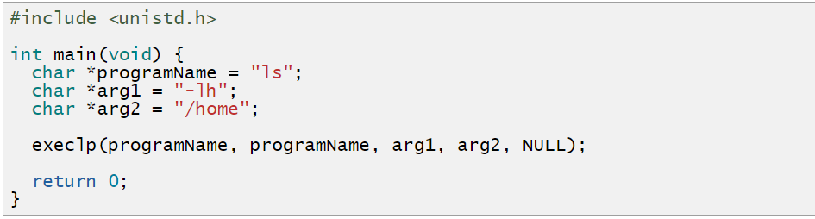

Slide 10
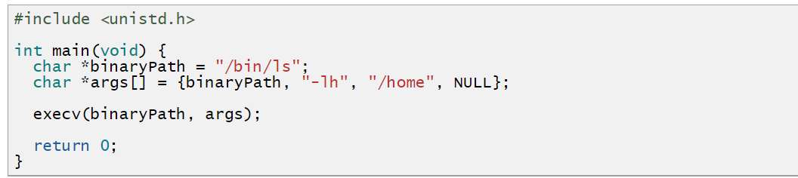
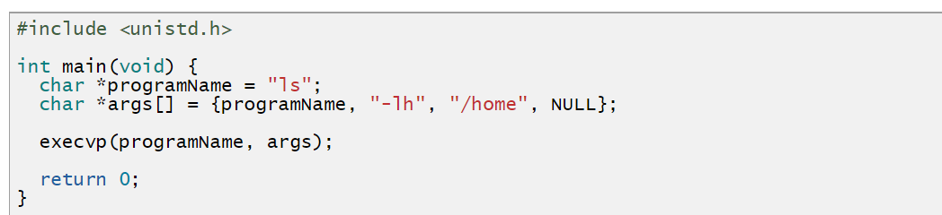

Slide 11
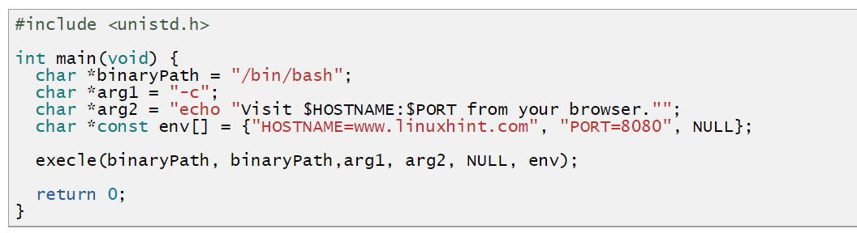
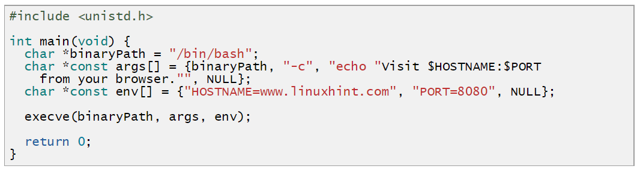

Slide 12
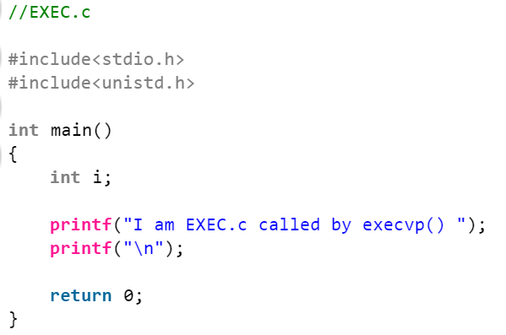

Slide 13
